Slide 1
Seeds of Greatness

Slide 2
Emma Curtis Hopkins
Teacher of Teachers
1849 - 1925

Slide 3
The Statement of Being
The Good I am seeking is my God,
God is my Life.
The Good I am seeking is my health,
God is my health.

Slide 4
The Good I am seeking is my strength,
God is my strength.
The Good I am seeking is my support,
God is my support.
The Good I am seeking is my defense,
God is my defense.

Slide 5
The Good I am seeking is my support,
God is my support.
The Good I am seeking is my defense,
God is my defense.
Life is God,
Truth is God,
Love is God,
Substance is God.

Slide 6
God is Intelligence,
Omnipresent, omnipotent, omniscient.
God is Life,
Omnipresent, omnipotent, omniscient.
God is Truth,
Omnipresent, omnipotent, omniscient.

Slide 7
God is Love,
Omnipresent, omnipotent, omniscient.
God is Spirit,
Omnipresent, omnipotent, omniscient.
And so it is!

Slide 8
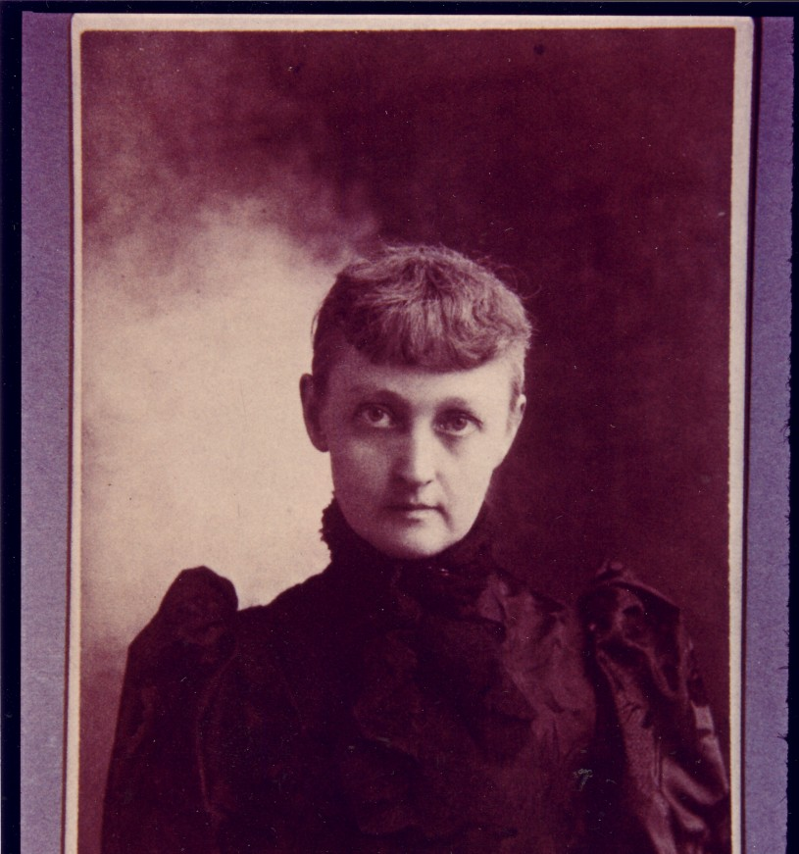
Found in Unity Archives
Notes:
September 2nd, 1849
Killingly, Connecticut
To Rufus and Lydia Curtis
Verified by CT 1850 Census – Josephine E. 1 year old (1853 not correct)
Very little known of her personal life
Read voraciously – had access to libraries
Learned Greek
Started out as teacher
She married George Irving Hopkins in 1874
They had one son John who dies before her in 1905
George was a curator and head of the physical science dept of Manchester Institute of Arts and Sciences and published a manual on Plane Geometry
They ended up getting a divorce

Slide 9
Emma was born in
Killingly, Connecticut on September 2, 1849

Slide 10
Josephine E[mma] was one of six children
of Rufus and Lydia Curtis.
May have attended Woodstock Academy
Listed in 1870 Census as school teacher.

Slide 11
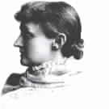
Biography by Rev. Joanna P. Rogers

Slide 12
1874 - Married George Irving Hopkins
1875 - One son: John born June 1875
1883 – met Mary Baker Eddy in Manchester, New Hampshire
received spiritual healing – condition unknown
1884 – went to Boston to enroll in Mary Baker Eddy’s class
1885 – editor of Journal of Christian Science
1885 – Dec. moved to Chicago – editor and CS Practitioner
1886 – Founded Emma Curtis Hopkins College of CS

Slide 13
1887 – San Francisco – 250 students attended
1887 – Oct, Nov, Dec – Milwaukee, Boston and New York where Harriet Emilie Cady attended her class
1888 – Established Christian Science Theological Seminary in Chicago
1889 – First ordination service – includes women
1890 – Conducted classes in Kansas City
Ordination of Charles and Myrtle Fillmore
1891 – Meets Malinda Cramer

Slide 14
1892 – Begins publication of 12 Studies in High Mysticism & Résumé
1893 – Sailed for England
1894 – Relocates to New York
1896 – Travels to Mexico – Son John is sick
1905 – John dies
Continues to teach one on one – from her home in New York – large clientele

Slide 15
1925 – April 8? Emma receives her Angel Wings at Highwatch Farm in Kent, Connecticut
She called her friend, Rev. Eleanor Mel and asked her to read from the Bible
Emma left this dimension with the words of John 17 “These words spake Jesus, and lifted up his eyes to heaven, and said, Father, the hour is come: glorify thy son, that thy son also may glorify thee.”
Emma Curtis Hopkins, Teacher of Teachers, is buried in Killingly, Connecticut

Slide 17
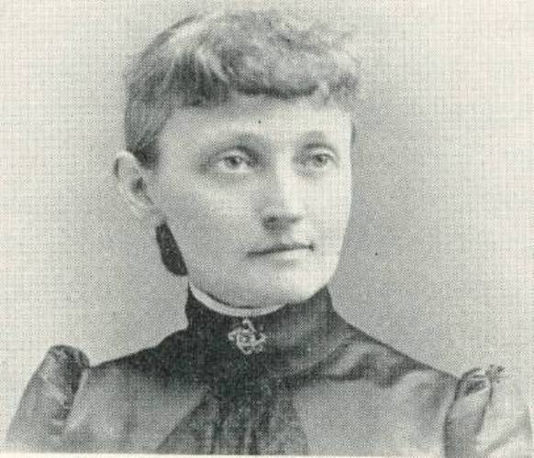
What life was like in Emma’s time

Slide 18
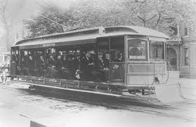
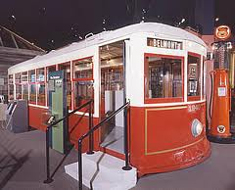
Street Cars

Slide 19
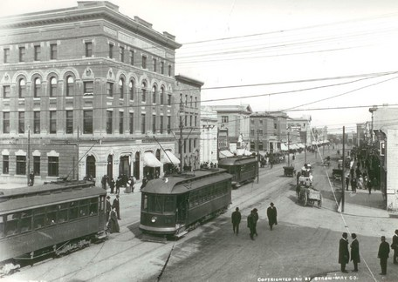
Chicago

Slide 20
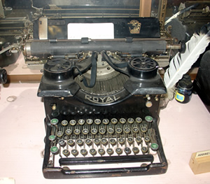
1867

Slide 21
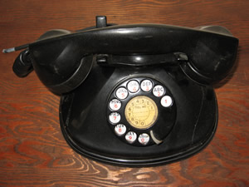
Beginning 1876 – this model from 1904

Slide 22
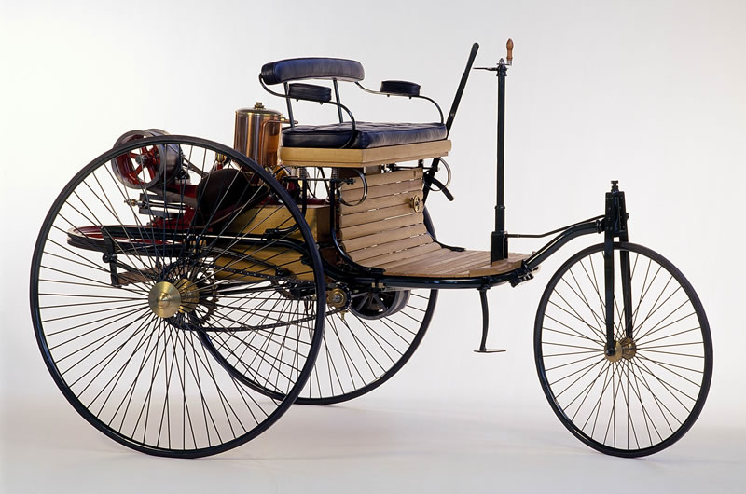
First Automobile, Karl Benz 1885

Slide 23
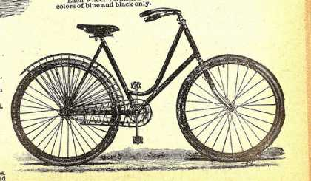
The Bicycle
1897

Slide 24
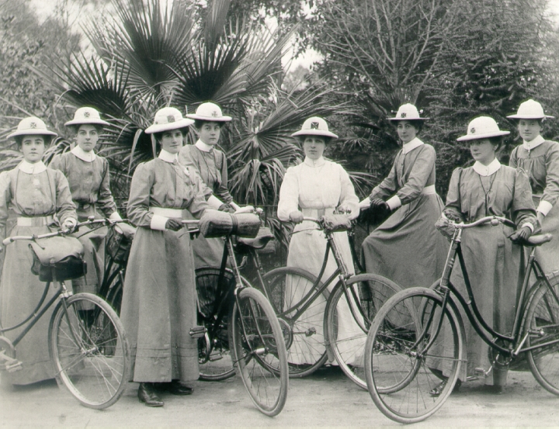

Slide 25
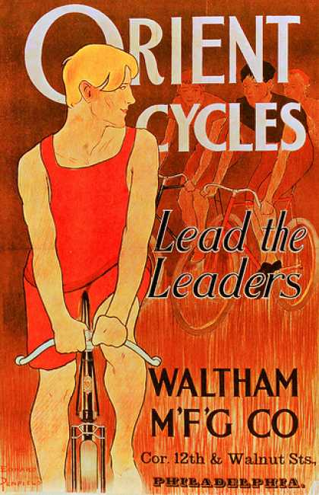

Slide 26
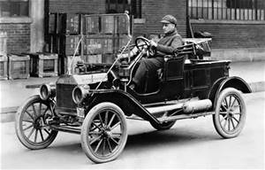
Ford Model T - 1908

Slide 27
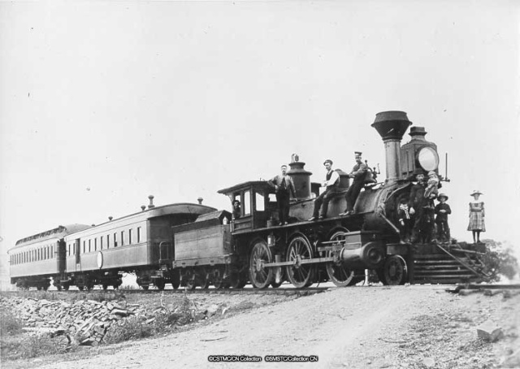
The Steam Engine

Slide 28
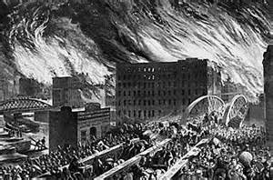
Great Chicago Fire 1871

Slide 29
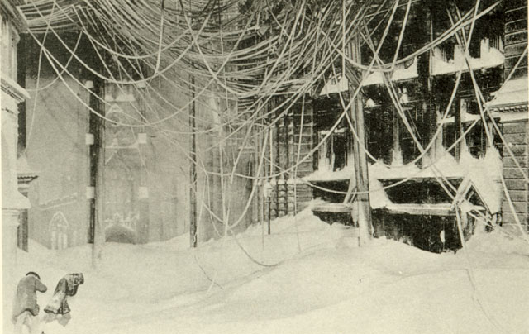
Blizzard of 1888
New York

Slide 30
World War I 1914-1918

Slide 31
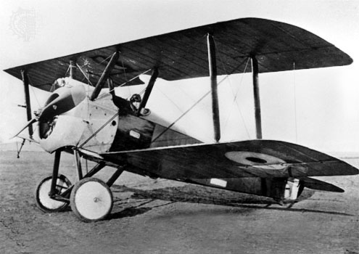
World War I Bi-Plane

Slide 32
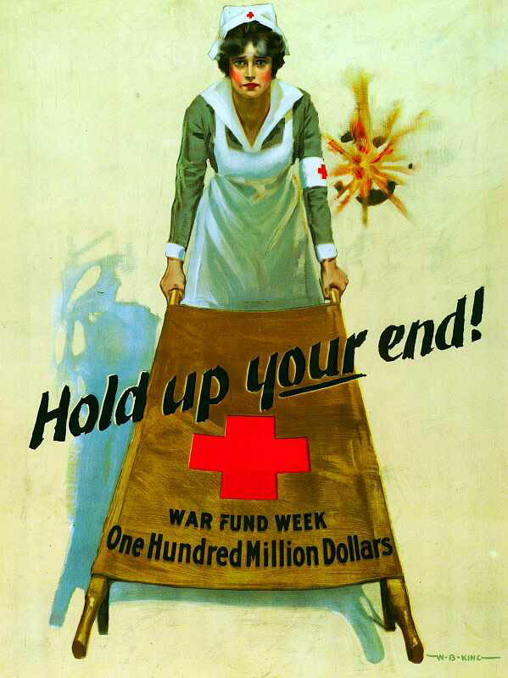
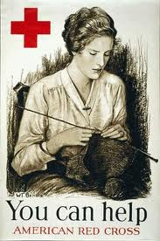

Slide 34
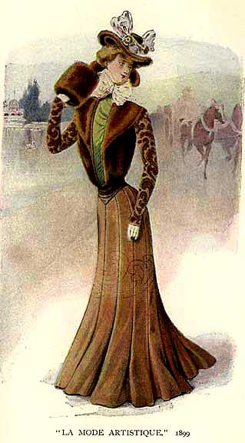
Emma Curtis Hopkins travelled extensively
16 States from
New York to San Francisco
England, France, Mexico
Maybe Australia
Her influence reached as many as 50,000 students

Slide 35
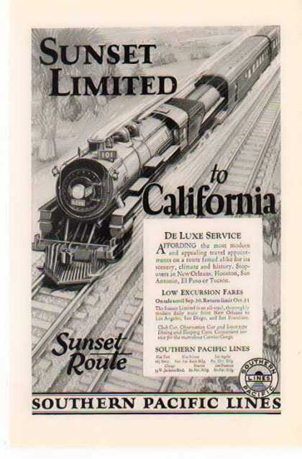
Taking the Train
from
New York
to
San Francisco

Slide 36
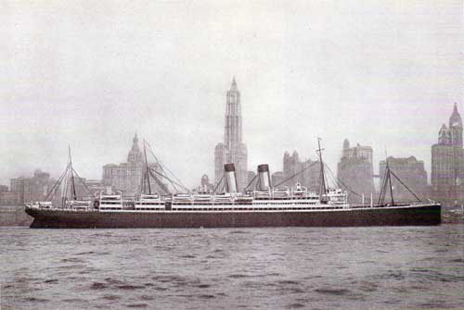
Ocean Liners
Notes:
White Star Line
Teutonic
Crossed the ocean in 5 days 20 hours – record time

Slide 38
Who influenced Emma?

Slide 39
Books and more Books
Sacred Scriptures
Greek Philosophers
Books on Mythology
Books on Theology
Books on Science
Notes:
Reading the World’s Scriptures – which is the one you resonate with
Study it 3 times
Apparently she learned Greek to read original works (normal in classical education)
This was the time of Tesla 1856-1943
He was an important contributor to the birth of commercial electricity.
Tesla's patents and theoretical work also formed the basis of wireless communication and the radio.

Slide 40
Hebrew & Christian Bible
Hindu Bhagavad Gita
Chinese Tao-te-King
Egyptian Book of the Dead
Mohammedan Al-Koran
Zoroastrian Zend Avesta

Slide 41
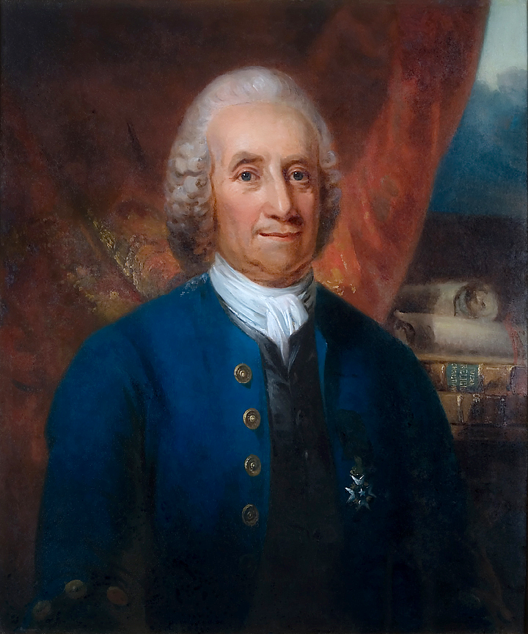
Emanuel Swedenborg
1688-1772
Notes:
Born in Stockholm
He was an incredible scientific genius. Father Lutheran bishop – studied science, mathematics and languages achieve his PhD at 21
Under the patronage of the king of Sweden he travelled throughout Europe. Visiting all the capitals and imbibing all that the leaders in mathematics, geology, anatomy, physics and other sciences could give him. He considered that in science lay the germ of the knowledge of soul and spirit.
In 1743 a profound change overtook him. His introduction into the spiritual world, his illumination, was commenced by dreams and extraordinary visions
He said that the eyes of his spirit were so opened that he could see heavens and hells and converse with angels - and spirits, but all his doctrines relating to the New Church came directly from God alone.
Refreshed his knowledge of Hebrew and commenced his great works on the interpretation of the scriptures.
His Arcana Coelestia alone is over 10,000 pages
Correspondences
Live life as a spiritual man – not a natural man – always seek the spiritual meaning in everything
The New Church Bryn Athyn, PA

Slide 42
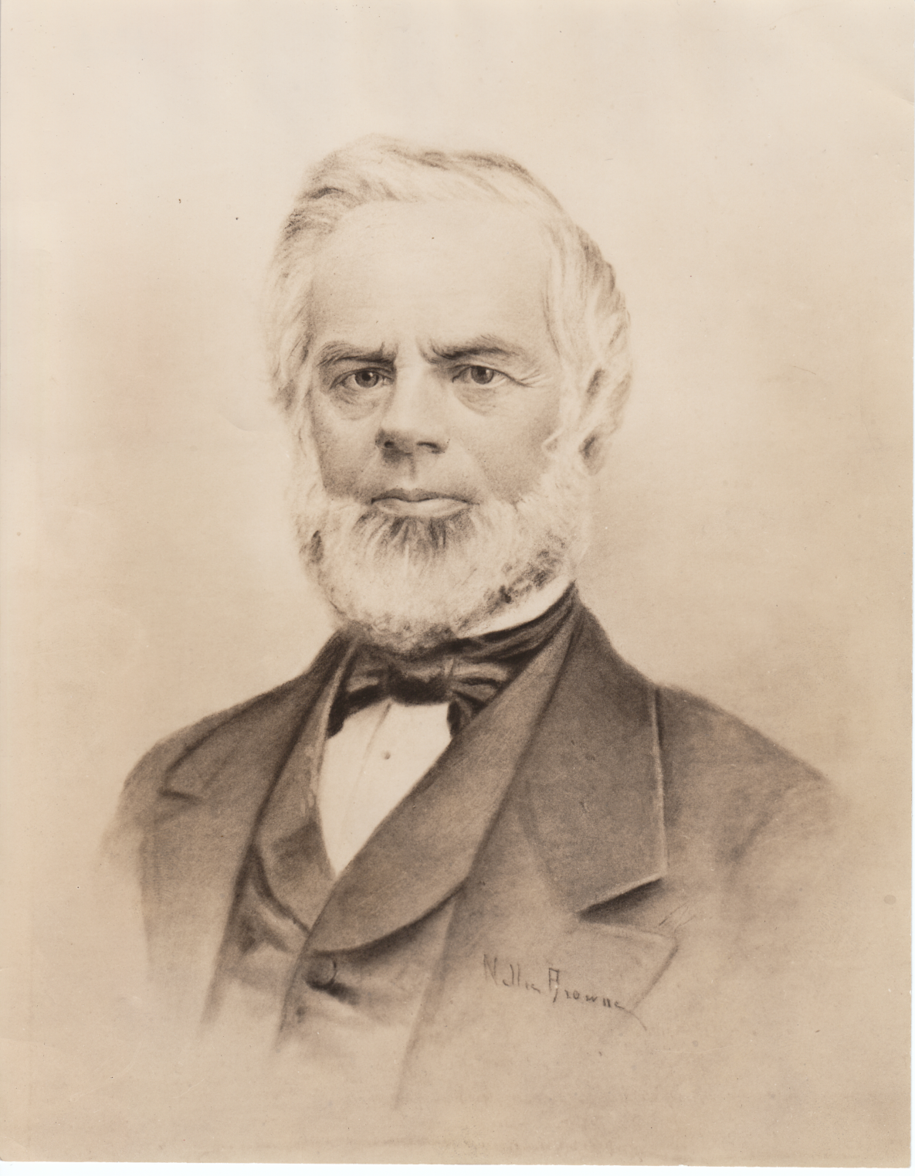
Phineas Parkhurst Quimby
1802-1866
Notes:
He never wrote to publish – his notes were salvaged by Julius Dresser and published
Quimby was one of those incredible people who come once in a lifetime
A curious man – not satisfied with just making clocks – wanted to know what makes them tick.
He experimented mesmerism with Lucius Burkmar who had psychic abilites.
Quimby began to realize that it was the effect of the patient’s belief that resulted in the cure. Began to develop his own ESP. His ability to change a patient’s belief in sickness was phenomenal – he became famous all over the East Coast.
Quimy did not teach but gave his patients notes to copy for themselves.
He claimed that his theory was not new, but was clearly illustrated in the Gospels.

Slide 43
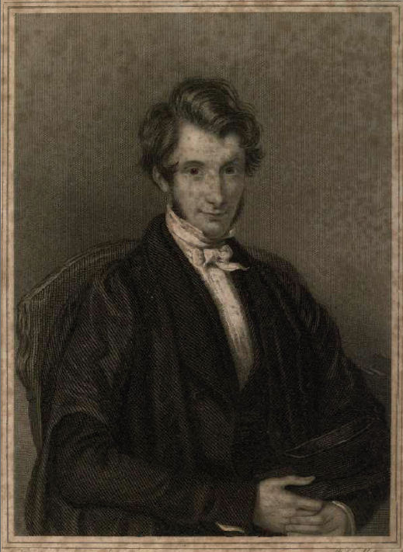
William S Adams
1814-1848

Slide 44
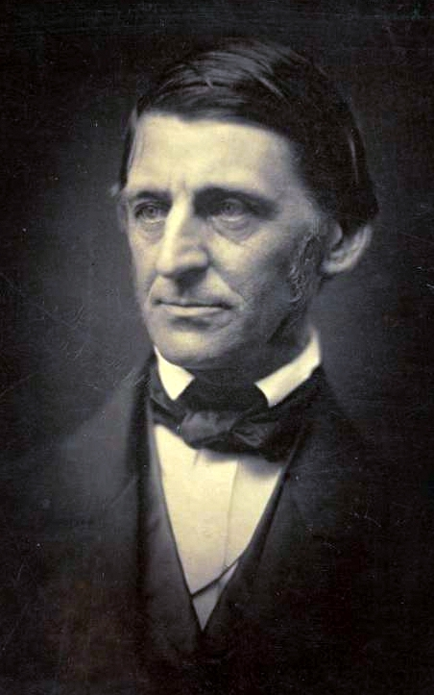
Ralph Waldo Emerson
1803 - 1882
Notes:
Travelled widely spent most of his life as a teacher and minister.
He went on to Paris, where he visited the Jardin des Plantes. He was greatly moved by the organization of plants according to Jussieu's system of classification, and the way all such objects were related and connected. Emerson's moment of insight into the interconnectedness of things in the Jardin des Plantes was a moment of almost visionary intensity that pointed him away from theology and toward science.
Seeing the budding Lyceum movement, which provided lectures on all sorts of topics, Emerson saw a possible career as a lecturer. On November 5, 1833, he made the first of what would eventually be some 1,500 lectures, discussing The Uses of Natural History in Boston. This was an expanded account of his experience in Paris.^{[43]} In this lecture, he set out some of his important beliefs and the ideas he would later develop in his first published essay Nature:
Nature is a language and every new fact one learns is a new word; but it is not a language taken to pieces and dead in the dictionary, but the language put together into a most significant and universal sense. I wish to learn this language, not that I may know a new grammar, but that I may read the great book that is written in that tongue.^{[44]}

Slide 45
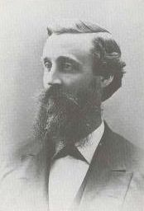
Warren Felt Evans
1817-1889
Notes:
A farmer’s son but prepared for college at 17
Became a Methodist minister – greatly esteemed
Started experimenting with healing/mental healing and psychotherapy
Joined Swedenborg church
Started writing books
In 1860 he was already well immersed in the power of the mind- and had used it to help heal some of his own afflictions
Sought healing from Quimby 1863
After two visits and his understanding of Swedenborgian Theology he started his own healing practice.
Wrote quite a few books between 1863 and 1886
His works give practical instruction and concepts that have been the foundation of the New Thought movement as carried on by Emma Curtis Hopkins

Slide 46
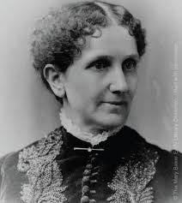
Mary Baker Eddy
1821-1910
Notes:
A fragile child, Mary Baker Eddy suffered from a number of physical complaints. The exact nature of these illnesses, and their possible psychosomatic or hysterical.
In an effort to find health in her adult years, she tried various medical experiments including homeopathy, allopathy, dietary cures, mesmerism, hydropathy, and other popular “cures” of the day.^{[10]} None of those methods brought lasting health.^{[11]}
In October 1862 she became a patient of Phineas Quimby, a magnetic healer from Maine. She benefited temporarily by his treatment^{[12]} and it is said by Quimby's supporters that his beliefs influenced her later thinking and writing.
She was the founder of Christian Science and wrote Science and Health.
In 1883 ECH met MBE and subsequently went to Boston to enroll in class
She took one class and became the Editor of the Journal of Christian Science
MBE and ECH parted ways because of a disagreement mostly over an article Emma wrote “God’s Omnipresence.”
MBE wanted to own the name Christian Science which was considered generic at the time – based on the Primitive Christianity of Jesus of Nazareth and the wisdom of his inheritance from the sages of the past.

Slide 47
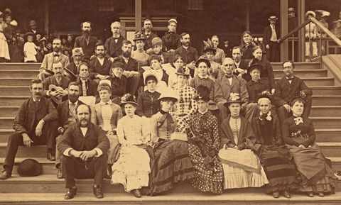
1883/84
Emma Curtis Hopkins
Class picture of Mary Baker Eddy students in Boston

Slide 48
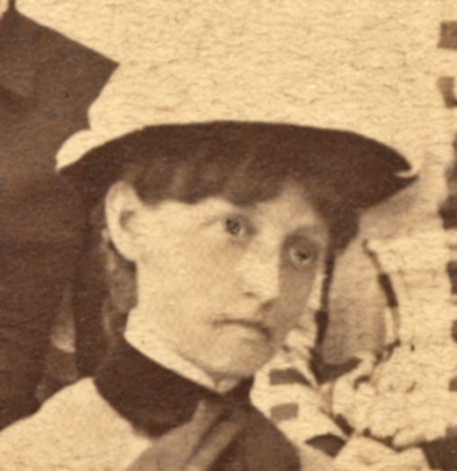
Emma Curtis Hopkins from the Mary Baker Eddy
class picture

Slide 49
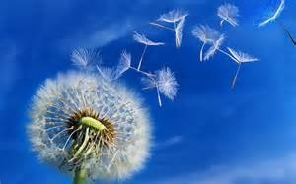

Slide 50
Who was influenced by Emma?

Slide 51
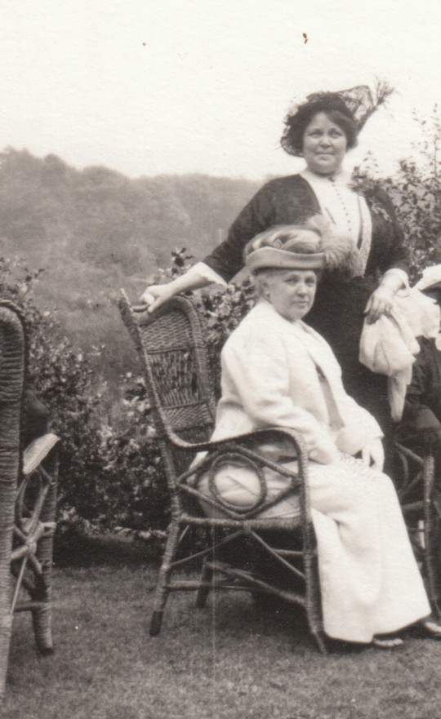
Annie Rix Militz
1856-1924
Harriet Hale Rix
1863- ? after 1884
Founders of the Home of Truth
http://thehomeoftruth.org/id4.html
The Rix Sisters

Slide 52
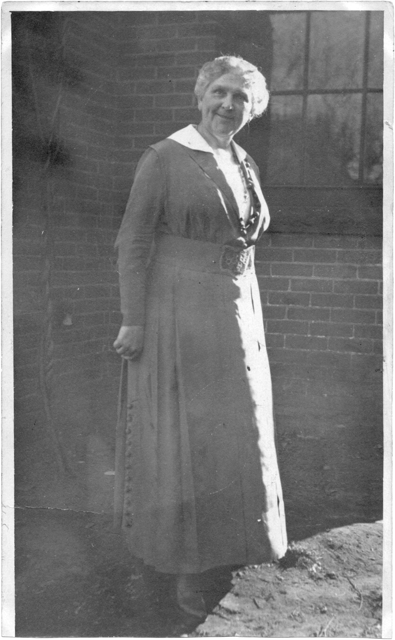
Nona Brooks
1861 – 1945
Described as a prophet of modern mystical Christianity.
A leader in the New Thought movement and a founder of the Church of Divine Science.
"a strength that came from conviction"

Slide 53
Myrtle Fillmore
1845-1931

Slide 54
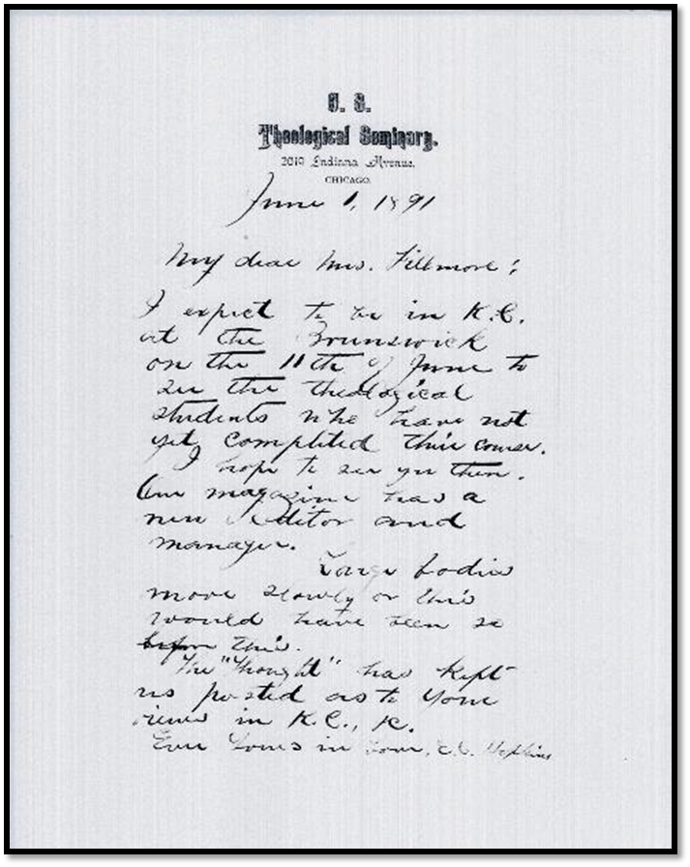
Emma Curtis Hopkins
To Myrtle Fillmore
June 1, 1891

Slide 55
Charles Fillmore
1854-1948

Slide 56
Received a certificate after taking a course instruction in the principles of Christian Science from Joseph Adams, a Normal Class Graduate of the Massachusetts Metaphysical College in Boston, Massachusetts 1887
Received an ordination certificate from the Christian Science Theological Seminary signed by Emma Curtis Hopkins, Annie E. Rix, and F.S. Vann Eps 1888

Slide 57
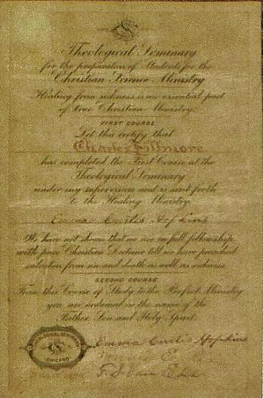

Slide 58
H. Emilie Cady
1848-1941

Slide 59
Ernest Holmes
1887 - 1960
Notes:
In 1924, Ernest Holmes spoke of Emma in a recording and said that "She was the flame that ignited Murray in New York, the Fillmores in Kansas City, the Brooks sisters in Denver, the Rix sisters in California and Burnell in Los Angeles, and they in turn had given light to America and the world." The value of the teachings of Emma Curtis Hopkins, Ernest felt, was the fact that she had not only experienced the consciousness of the mystic herself but imparted spiritual conviction in such a way as to awaken a corresponding consciousness in her students... She offered no debate: "What she said was it and that was that; and like some ancient seeress, dispassionate but not cold, she powered it with a conviction so great that it imparted something — a definite impartation, in fact, so great that at times it was almost like a wind, like the 'psychic breeze,' a phenomenon familiar to inquirers. It was something alive, animated and inspiring. It was due neither to her words nor to her manner. She awakened an awe which was at once personal and impersonal, identified with her and yet something more."**

Slide 60
Other notable Emma Students
Frances Lord
Mrs. Bingham
Helen Wilmans
Charles A. Barton
Josephine Barton
Ella Wheeler Wilcox
Elizabeth Towne
Out of 1000s of students who paid $50 for a 2-week course of 12 Lessons

Slide 61
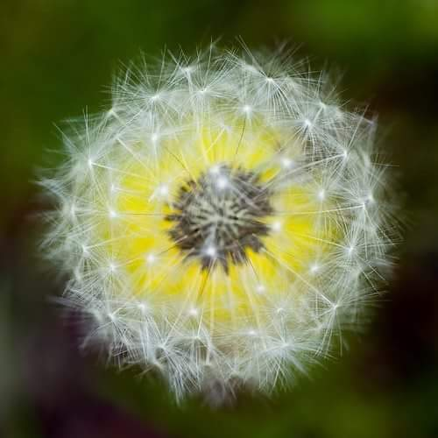

Slide 62
Publishing and teaching Emma’s
Works
Today

Slide 63
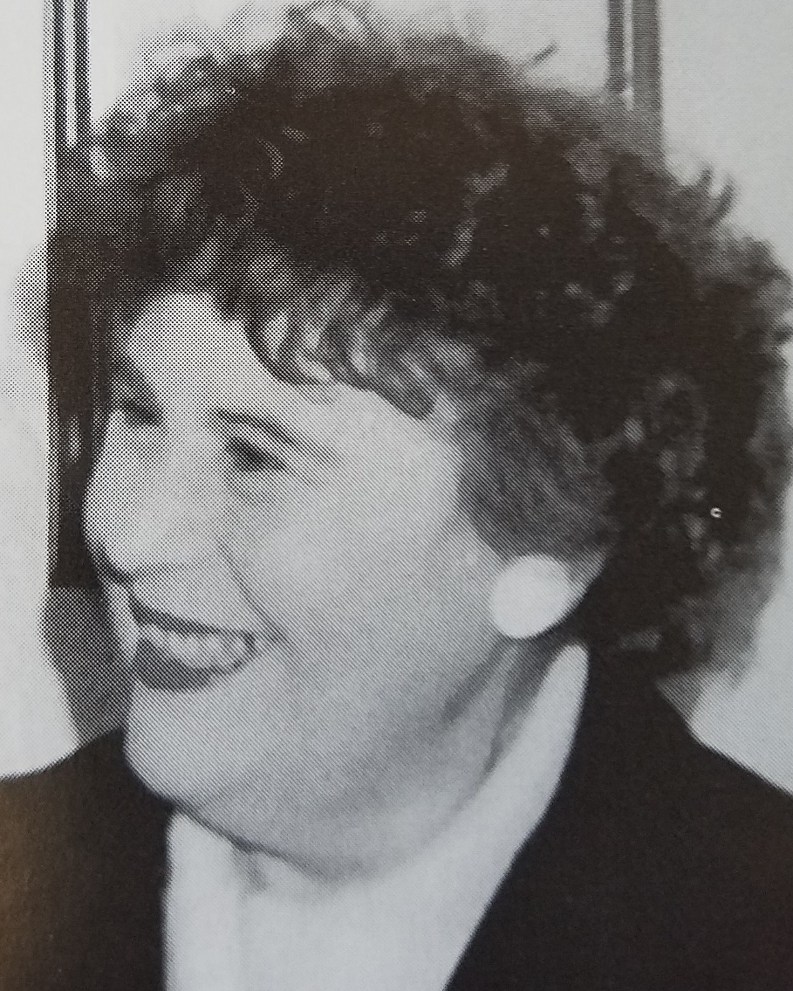
Rev. Marge Flotron
Ministry of Truth
International
Chicago

Slide 64
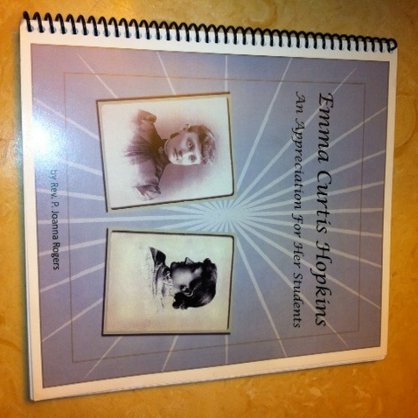
Rev. P. Joanna Rogers
Desert Church of the Learning Light
http://desert.xpressdesigns.com/

Slide 65
Beloved Rev. P. Joanna Rogers has made her transition in 2020. Her books continue to be available for purchase from her website:
http://desert.xpressdesigns.com/
learninglightministries.org/ bookorders@xpressdesigns.com

Slide 66
Ferne Anderson
Ruth Miller
Gail Harley

Slide 67
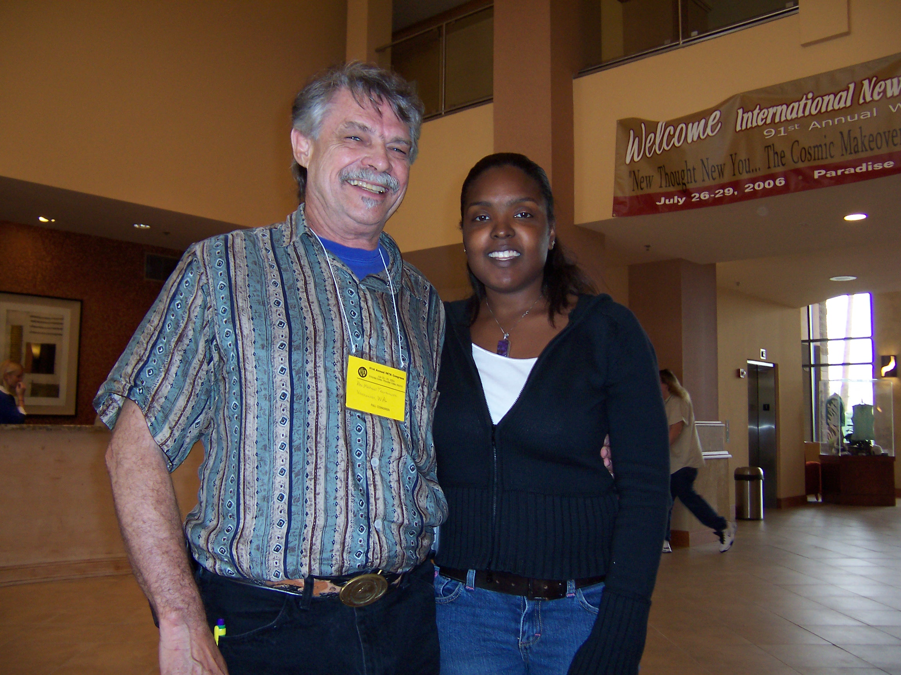
Rev.
Michael Terranova
Rev. Natalie Jean

Slide 68
Wisewomanpress.com
Bible Interpretations 1 -21 Self Treatments and Radiant I Am
Drops of Gold
The Genesis Series
High Mysticism
Résumé
The Gospel Series
Class Lessons of 1888
Judgment Series in Spiritual Science
Esoteric Philosophy: Deeper teachings in Spiritual Science

Slide 69
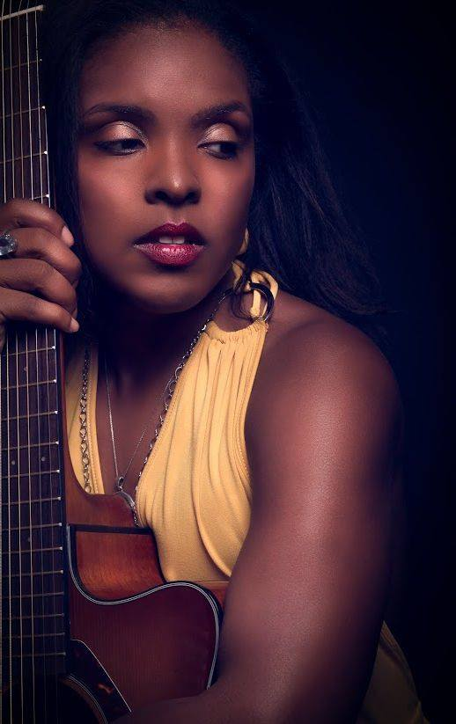
Rev.
Natalie Jean
Emma Curtis Hopkins Theological Seminary

Slide 70
Emma Curtis Hopkins Theological Seminary
The mission of the Emma Curtis Hopkins Theological Seminary is to help every individual lift the veil of human conditioning, to allow Spirit to be revealed.
God works only in Truth. All Truth is all God.
Rev. Natalie Jean
Kensington, MD
http://www.emmacurtishopkinstheologicalseminary.com/Home_Page.php

Slide 71
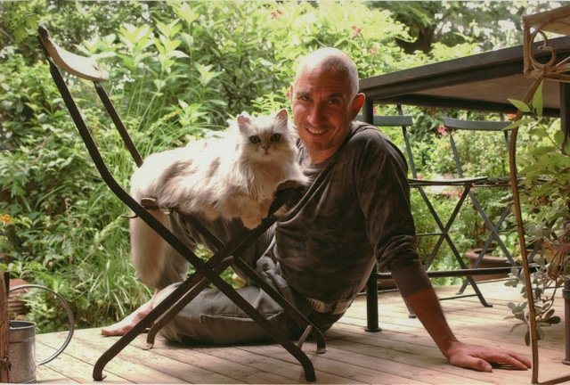
Rev. Patrice Julien
Emma en Français

Slide 72
Rev. Patrice Julien has translated The Radiant I Am and Self Treatment into French
Available from Amazon:
https://www.amazon.com/Auto-Traitements-Rayonnant-Je-Suis-French/dp/0615628338

Slide 73
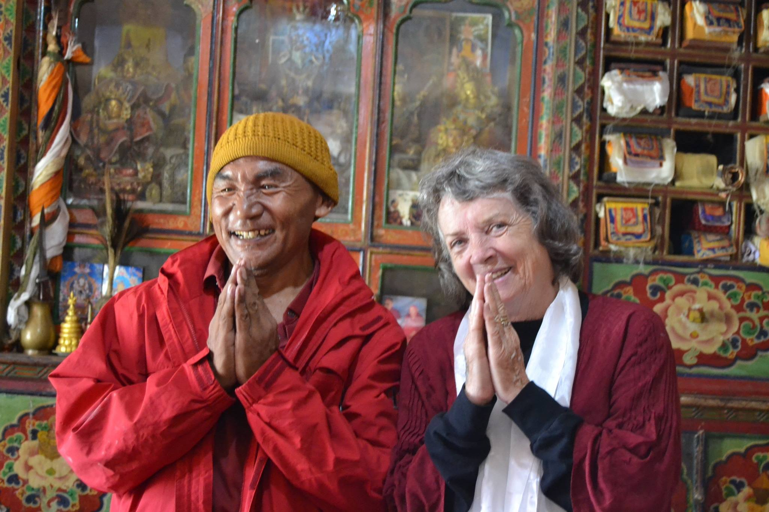
Isabell Van Merlin

Slide 74
Isabell VanMerlin has recorded the book SELF TREATMENTS published by Wise Woman Press. The MP3 is available for purchase on our website https://highwatch.org
She has also published Naming God with Clouds illustrating the numerous descriptions of God used by Emma Curtis Hopkins with beautiful photos of clouds. Available from Amazon.

Slide 75
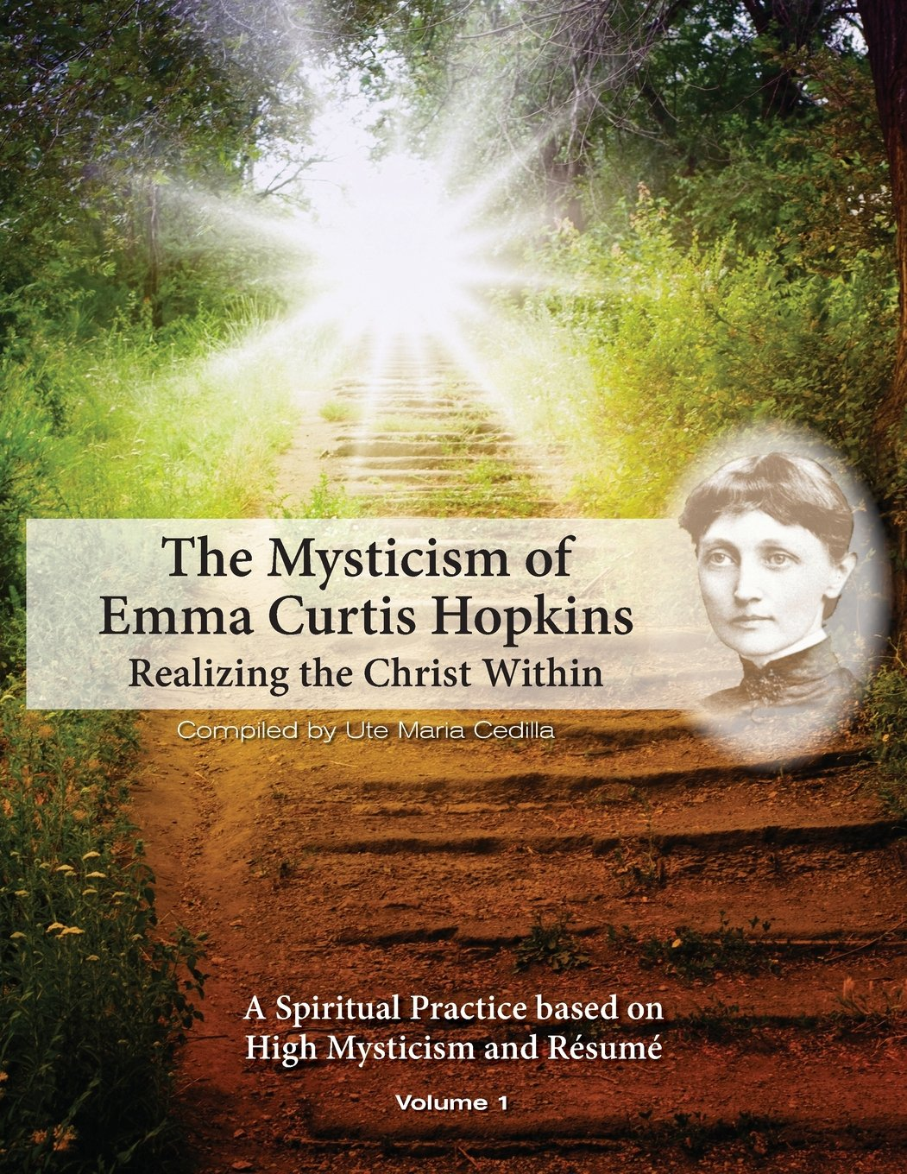
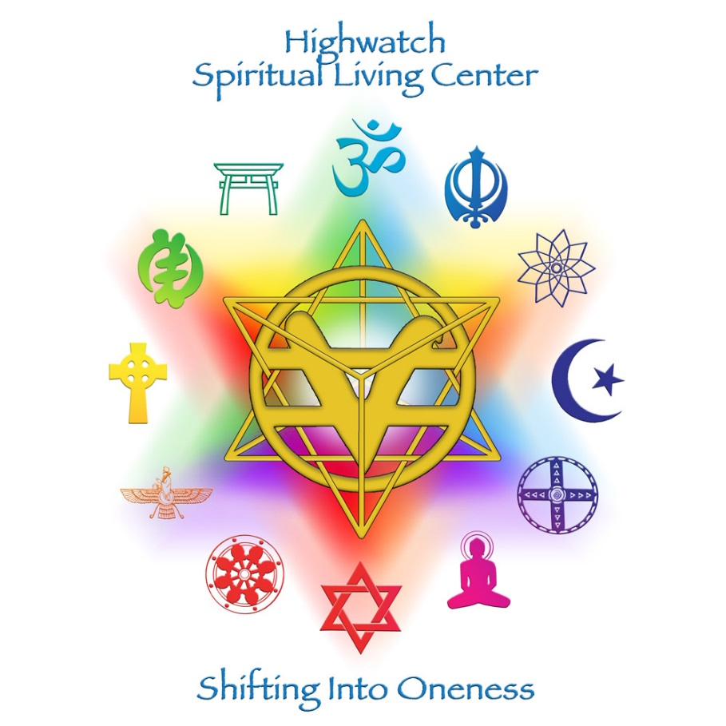
Rev. Ute Maria Cedilla

Slide 76
Emma on the Internet
www.emmacurtishopkins.com
http://groups.yahoo.com/group/emmacurtishopkins
http://www.blogtalkradio.com/RevNatalieJ-
http://desert.xpressdesigns.com/
http://www.emmacurtishopkinstheologicalseminary.com/

Slide 78
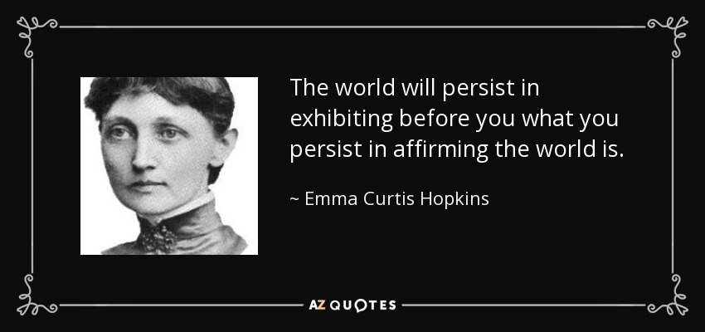

Slide 79
Colleen Patrick
reads
Emma Curtis Hopkins
Scientific Christian Mental Practice
http://emmacurtishopkinsaudio.com/

Slide 80
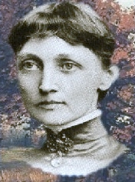
The Radiant I Am - Animated
..\Videos\The Radiant I Am by Emma Curtis Hopkins - YouTube2.rv

Slide 82
Teacher of Teachers

Slide 83
The Sacred Books of all ages mention three sciences:
Material,
Mental,
and Mystical.
Notes:
The Sacred Books of all ages mention three sciences: Material, Mental, and Mystical.
Material Science declares laws that are sure, such as that iron sharpens iron and hydrogen and oxygen clashing together fall into thirst-quenching waters.
The Sacred Books proclaim a Mental Science to which the world can subscribe as, “All that we are is made up of our thought.”
Mystical Science announces the miracles of “Predi­cateless Being” setting the ways of matter at naught, and nullifying the thoughts of mind:
“The flesh profiteth nothing.”(Jn 6:63)
“Take no thought.”(Matt 6:25, 34, Matt 10:19, Mk 13:11)
“In such an hour as ye think not.”(Matt 24:44, Luke 12:40)
Mystical Science is a chalice of golden wine passed along to the children of earth by John’s angels of the Apoca­lypse. It is a new song for the hearts of the Children of the New Age. ECH

Slide 84
The Twelve Gates
Lessons one through six
teach
How to realize the Christ within
Lessons seven through twelve
teach Ministry
Realizing the Christ One in all
Notes:
THE WORD: Statement of Being only God, repentance
DENIALS: Remission, Freedom from faults, appearances, nothing but God
AFFIRMATIONS: Forgiveness, giving ourself to God- all is good or God
FAITH: Knowingness, confidence, God as Truth
WORKS: The work of mind having faith in God
UNDERSTANDING: Understanding the way things work, God is us, wisdom
HERITAGE: there is no origin of creation except in spirit
TRUTH: Rending the veil, finding perfection, looking past appearances
RIGHTEOUS JUDGMENT: goodness or God-ness in all – seeing right action, holiness
SELF IN ALL: Fearlessness, oneness, joy, peace within, giving self to God
HIGHEST SPIRITUAL UNDERSTANDING: the way of wisdom , living up to your highest spiritual understanding, believing in your own perfection, oneness, crossing the bar
BEINGNESS-PRAISE: the crown of glory, being completely one with God, knowing you are God, Praise

Slide 85
In her Judgement Series Emma lists the 12 Chapter themes
The Word
Denials
Affirmations
Faith
Works
Understanding
Inheritance
Truth
Holiness
Forgiveness
Wisdom
Free Grace

Slide 86
Emma Curtis Hopkins imparted conviction in her classes during her lifetime.
Today, there is a transmission of consciousness through her works if the student is ready and willing.

Slide 87
Be encouraged.
If things are not going the way you'd like, understand that things are always working for your good. Keep expecting good to happen. How? Prepare for good. Expect more good. Give thanks for good--even before it shows up in your life. I dare you to encourage yourself even as you manage the facts of life.
Posted by Rev.Sheila McKeithen 4-20-2017

Slide 89
The Mary Baker Eddy - Emma Curtis Hopkins Paradigm
Based on a Thesis by
John K Simmons
Western University

Slide 90
We have uploaded a paper by Western Illinois University professor John K. Simmons’ paper on our website https://highwatch.org It is no longer available on line. It is an important thesis that sheds light on the relationship between Mary Baker Eddy and Emma Curtis Hopkins from a higher, healing perspective.

Slide 91
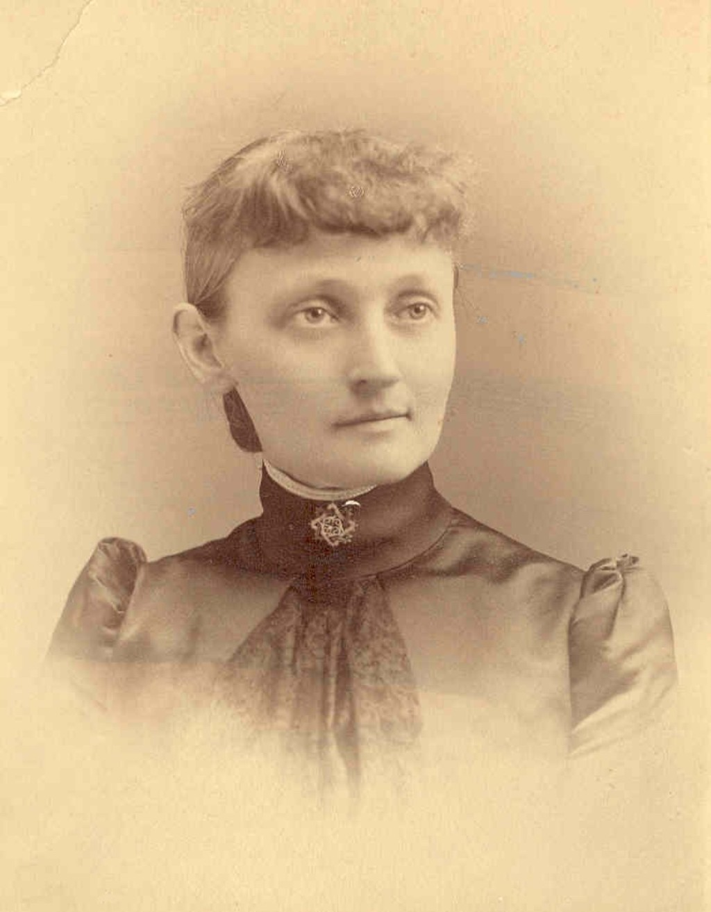
Mary Baker Eddy
Emma Curtis Hopkins

Slide 92
Born of God
Notes:
Born of God – Born of God – Born of God!
My thoughts are born of God.
My words are born of God.
My will is born of God.
My actions are born of God.
This is truth.
It is a touch of my will-o'-the-wisp thoughts on reality to say
they are born of God.
God is here.
I touch my face against God and its beauty is the beauty of God.
I lay my gold on God's here substance,
and its purchasing power is the Jesus Christ ability.
God is here.
Behind me is God. I lay all I have there and say unto it:
"Born of God!"
God is before me. I put down all that I have there and say unto it:
"Born of God!"
On the right I stretch my hand and lay it upon God,
and lo! my hand is born of God. It works whatsoever is good.
On the left hand, there is my resting-place.
Under me is the eternal God.
My feet touching God go not astray.
I remember where I am, and born of God I am all God.

Slide 93
Born of God
Born of God – Born of God – Born of God!
My thoughts are born of God.
My words are born of God.
My will is born of God.
My actions are born of God.
This is truth. It is a touch of my will-o'-the-wisp thoughts on reality to say they are born of God. God is here.

Slide 94
I touch my face against God and its beauty is the beauty of God.
I lay my gold on God's here substance, and its purchasing power is the Jesus Christ ability.
God is here.
Behind me is God. I lay all I have there and say unto it: “Born of God!”
God is before me. I put down all that I have there and say unto it: “Born of God!”

Slide 95
On the right I stretch my hand and lay it upon God, and lo, my hand is born of God.
It works whatsoever is good.
On the left hand, there is my resting-place.
Under me is the eternal God.
My feet touching God go not astray.
I remember where I am, and born of God I am all God.

Slide 96
And so it is !!!

